Slide 1

DriverPass System Analysis
Dani Yosopov
Notes:
[No speaker notes required for this slide.]

Slide 2

System Requirements
Functional
The system shall give detailed information about driving reservations
The system shall allow the users and admins to schedule and modify training by time and date.
Nonfunctional
The system requires a username and password for access to the application.
The system auto saves the user’s progress
Notes:
The functional requirement "system shall allow the users and admins to schedule and modify training by time and date" will help with the ability to modify and change in case of scheduling emergency adding the functional requirement "system shall give detailed information about driving reservations" will allow all the users involved in the appointment to keep been in the loop and be updated with the most recent change to avoid confusion.
The non-functional requirement "system requires a username and password for access to the application." This will add to the application security and integrity of the user's private information.
In case of system malfunctions, the most recent progress of the user won't be lost instead it will be autosaved so the user could proceed from the place he left.

Slide 3
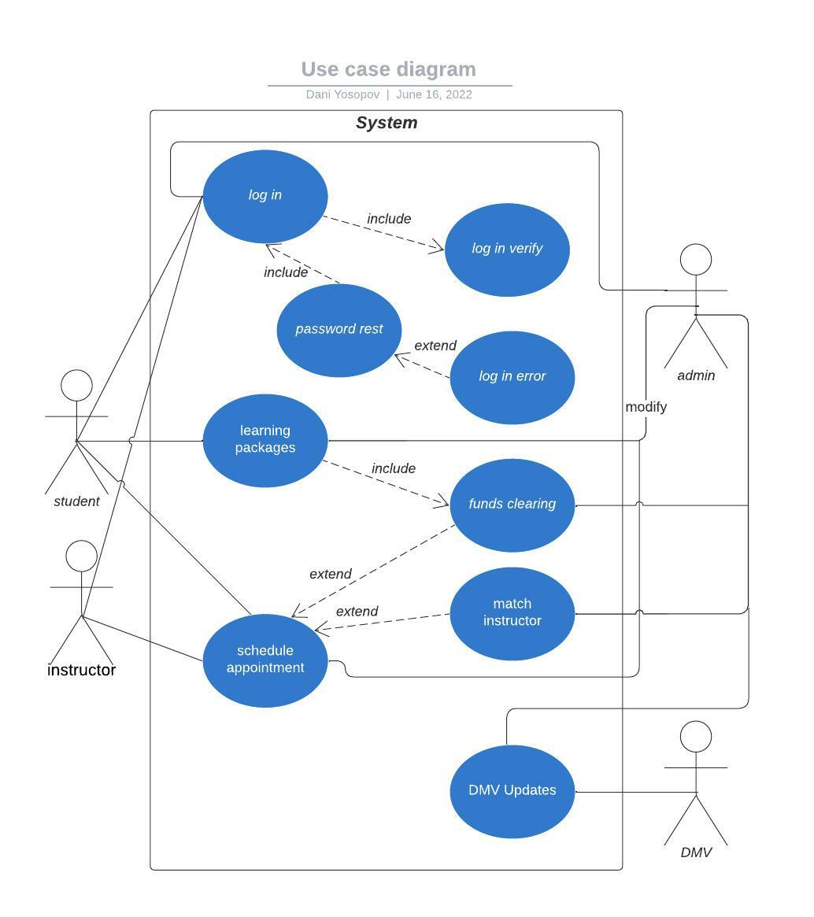
Use Case Diagram
Notes:
This use case diagram shows the admin, student, and instructor will have the access to log in, the system will verify the login if it is wrong it will send a login error message. The student has access to the learning packages, and the admin will have the access to modify the learning packages. After the student funds are cleared they will have access to schedule an appointment with an instructor which will have access to it as well, the admin will have the ability to modify the schedules and match the instructor with the student. The admin will have access to the DMV update.

Slide 4
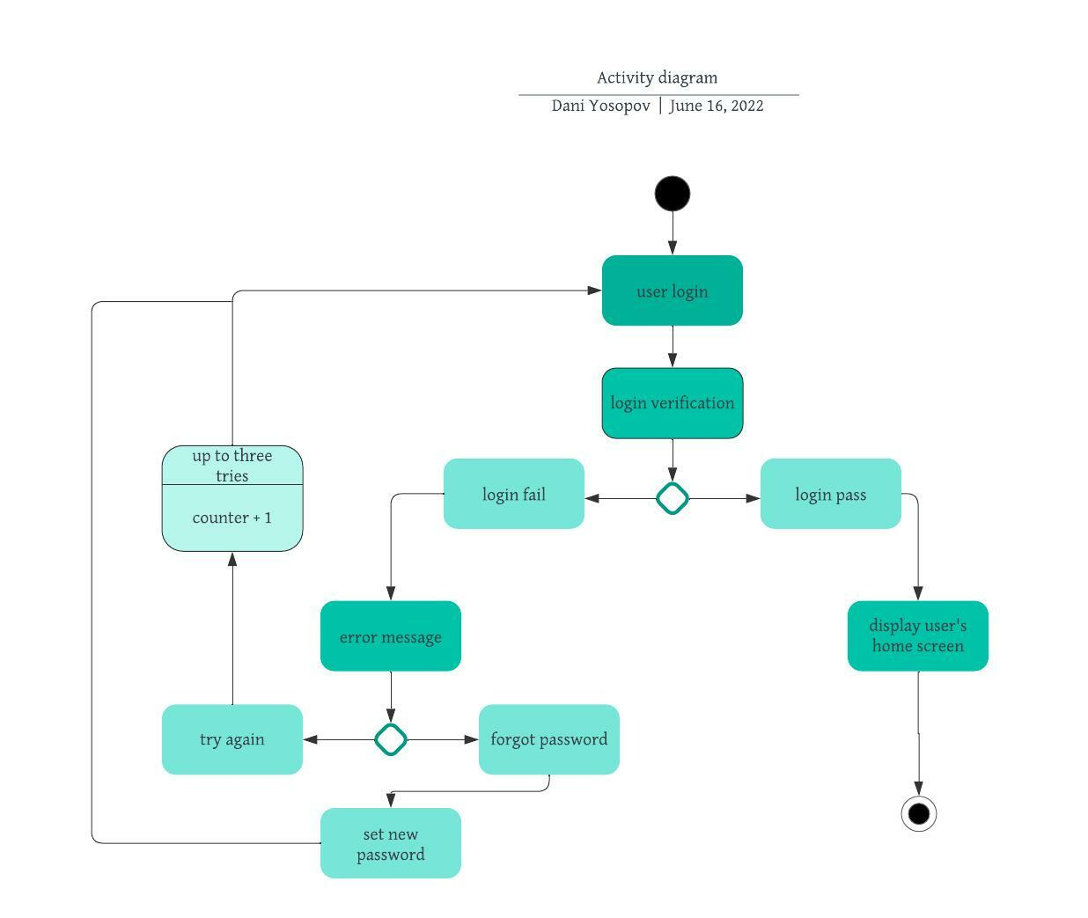
Activity Diagram
Notes:
The first step is for the user is entering his username and password and submit it, then the system will check if the information is correct by comparing it with the original the user entered in the signup prosses.
If the information indeed matches the application homepage will be displayed to the user and the activity is over, but, if the information is not matching an error message will be displayed. From there we have two options to choose from either try again but with limited attempts in this case only 3, or to press forgot password which will rest your password.

Slide 5
Security
User login
Cloud-based platform.
Notes:
In order to access the application, the user must log in using their username and password.
After a 3 wrong attempts, the user account will be locked.
The forgot password module will be available and will work based on user account info like email, phone number, or safe word.
Security will be taken care of by a Cloud-based platform.

Slide 6
System Limitations
The system will stop functioning once internet connection is lost
No appointment before the current date and time.
Notes:
The system will stop functioning once the internet connection is lost. All the data in the application is provided by servers through an internet connection the user's device cannot display the data or the application.
The system will not allow users to schedule appointments before the current date and time.

